Slide 1
Airline Management Suitable
Examination Project

Slide 2
MY NAME : MD. RAHAMAT ULLAH
Round : 39
Module :6

Slide 3
Requirement Project :
1. Java Swing and Jdbc Projects .
2. NetBeans Use.
3. Use Case
4. Diagrame Use.
5. Mysql Database.

Slide 4
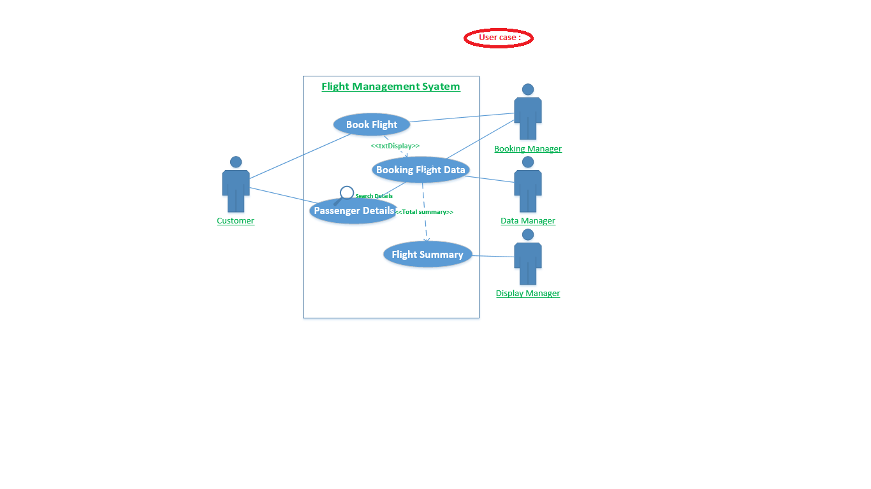
Use Case :

Slide 5
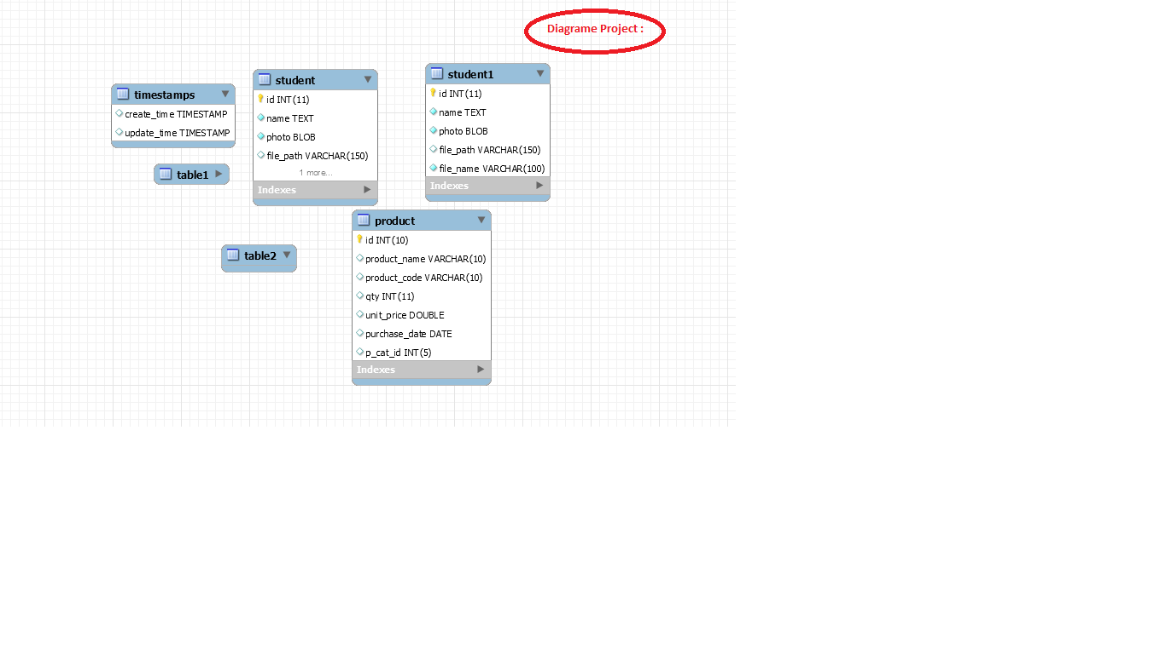
Diagrame :

Slide 6
LogIn Information :

Slide 7
Booking Flight :

Slide 8
Passenger Details :

Slide 9
Booking Flight Details :

Slide 10
Flight Cancel Details:

Slide 11
Search Details Flight :

Slide 12
Flight Contact Information :

Slide 13
Details Privious Information :

Slide 14
Total Tranction Information :

